Slide 2
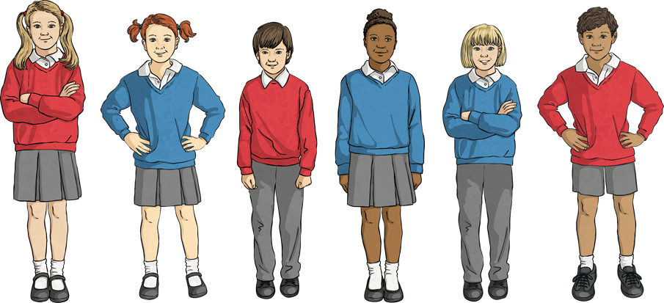
What Is Mental Health?
‘A person’s condition with regard to
their psychological and emotional well-being.’
Mental health problems can affect how a person feels, thinks and behaves. Around one in four people in Britain and about one in ten children and young people suffer from mental health problems (that’s about three in every classroom).

Slide 3


Can You Think of
Any Mental Health Problems?
Here are just a small selection of problems that people may experience:
anger
anxiety and panic attacks
depression
eating problems
Click on a mental health problem to learn more about it.

Slide 4

Anger
Have you ever felt angry?
Anger is a natural emotion that everyone feels. It becomes a problem when it is harmful to others or yourself.
Ways of dealing with anger:
counselling/psychotherapy/cognitive behavioural therapy (CBT)
anger management programmes through NHS/online/private courses
conversations with your GP
talk to the Respect Phoneline
take a course run by the Freedom Programme

Slide 5
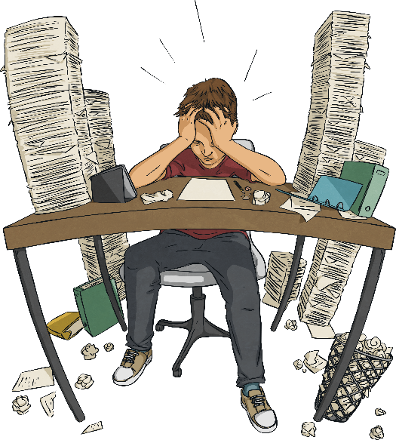
Anxiety and Panic Attacks
What do you think it feels like to feel anxious?
Fight or flight response – This is a response we experience to protect ourselves from danger by preparing the body to either fight the danger or flee it. This can turn into a panic attack. Your heart rate may quicken and you may begin to sweat, feel faint or feel sick.
Can you think of some situations that could make you feel anxious in today’s society?
Have a test/exam
Starting a new school/job
Having an argument with a loved one
Moving away from home
Getting married or divorced
Anxiety and Panic Attacks continued…

Slide 6
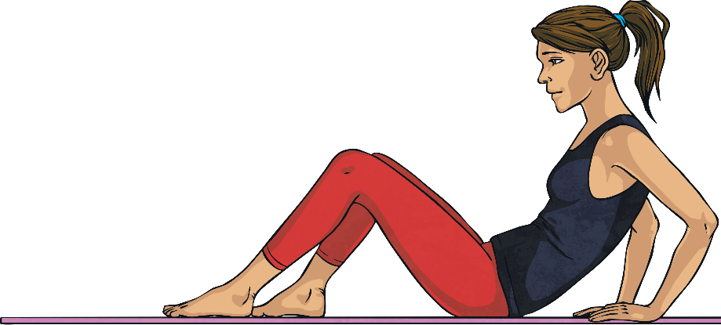
Anxiety and Panic Attacks
When does it become a problem?
As it is a natural response, we will probably all have experienced this anxious or panicked feeling. However, when it becomes a regular occurrence in day to day life, it may become an issue.
Ways of dealing with anxiety and panic attacks:
breathing
meditation
yoga
positive thinking
‘talking’ treatments
medication

Slide 7
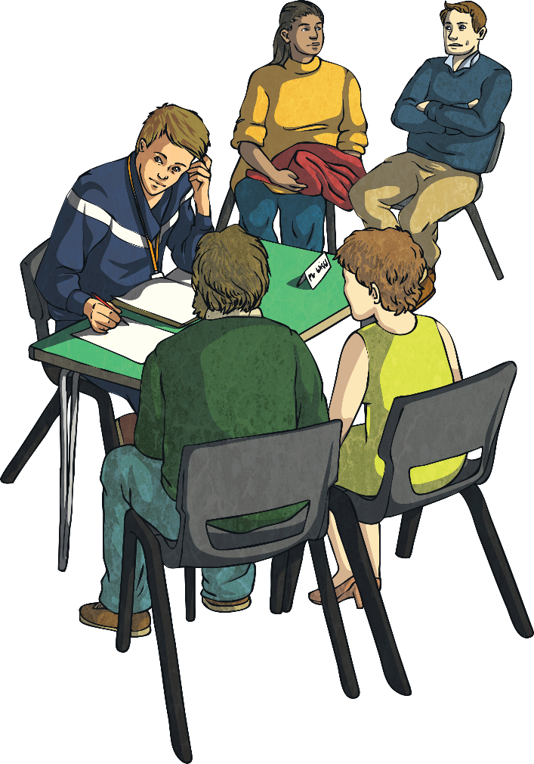
Depression
How do you think depression is different from
feeling ‘low’?
Like the other mental health problems
discussed, depression becomes an issue
when it begins to affect your daily life.
Some people will struggle to do daily
tasks and may even have suicidal thoughts.
Listen here to a group of people
talking about their experiences with
mental health.
Depression continued…

Slide 8
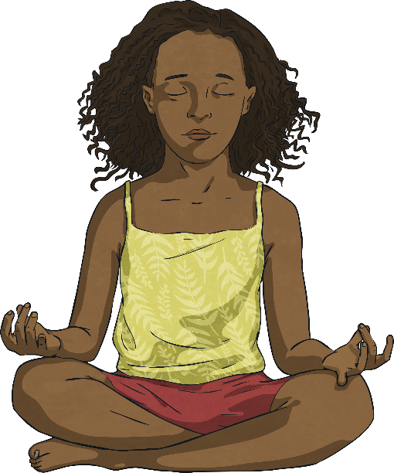
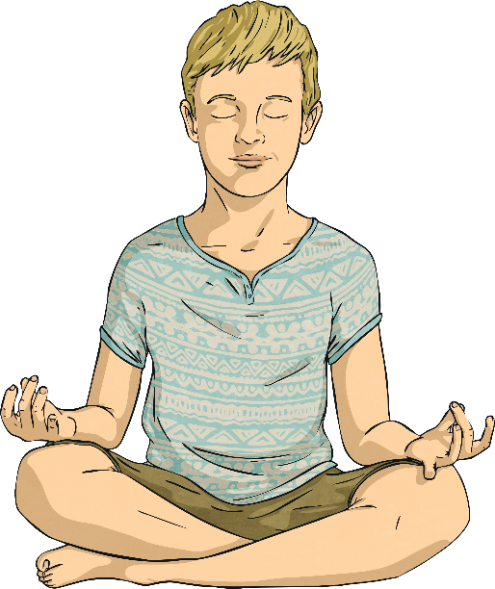
Depression
Ways of dealing with depression:
counselling/psychotherapy/cognitive behavioural therapy (CBT)
NHS/online/private courses
yoga/meditation/mindfulness
medication

Slide 9



Eating Problems
Food is a very important part of our lives and sometimes, due to how we are feeling, our relationship with food may change. This may be because of feeling stressed or anxious, or a conscious decision to watch what you eat, however if you are not eating a balanced diet it can be very dangerous.
Many eating disorders are started as a way of controlling something else that has become stressful in your life.
Ways of dealing with eating problems:
counselling/psychotherapy/cognitive behavioural therapy (CBT)
visiting a clinic/talking to a dietician/psychotherapist
medication

Slide 10


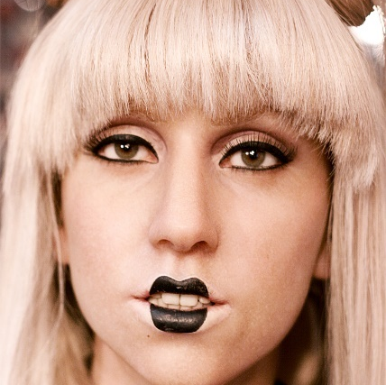

Celebrities
Anyone can experience mental health problems. Here are just a handful of celebrities who have spoken out about their experiences:
Justin Bieber
depression
Kendall Jenner
anxiety
Lady Gaga
post-traumatic
stress disorder
Dwayne Johnson
depression
depression
“Justin Bieber” by iloveJB123 is licensed under CC BY 2.0
“Lady Gaga” by ana_lora is licensed under CC BY 2.0
“Kendall Jenner” by Walt Disney Television is licensed under CC BY 2.0
“Selena Gomez” by SGForeverC7 is licensed under CC BY 2.0

Slide 11



Celebrities
Brad Pitt
depression
Prince Harry
living with the
grief after his
mother’s death
Jade Thirlwell
anorexia
depression
“Brad Pitt” by GabboT is licensed under CC BY 2.0
“Prince Harry” by E.J. Hersom is licensed under CC BY 2.0
“Jade Thirlwell” by Emmacmd is licensed under CC BY 2.0

Slide 12
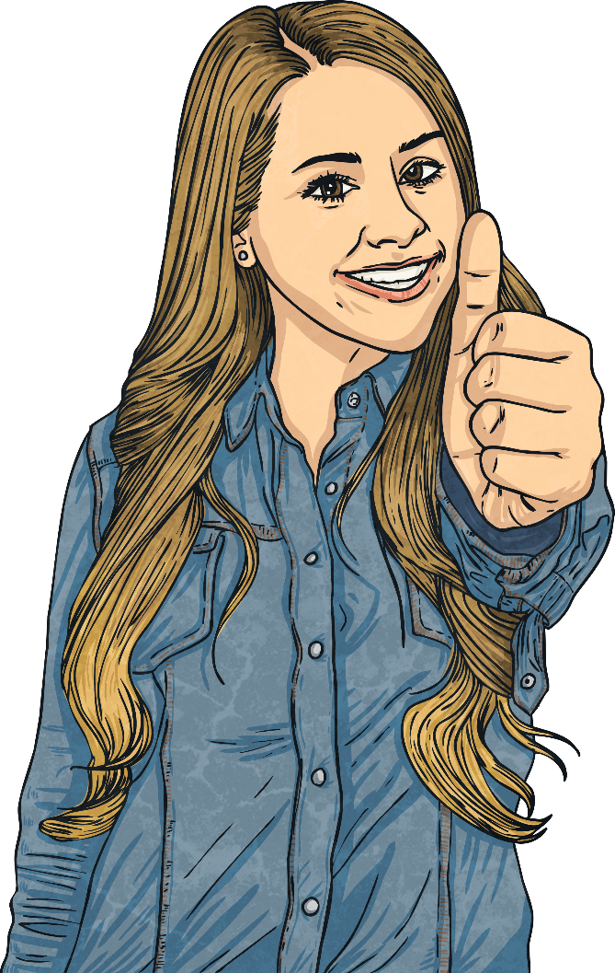
Positive Mental Health
Discuss some of the ways you can deal with a mental health problem.
Have a go at one of the following activities and after, discuss how it made you feel while you did it.
Mindfulness Colouring Sheets
When I am Feeling Activity Sheet
Anger Map Activity Sheet
Colour Your Feelings Activity Sheet

Slide 13
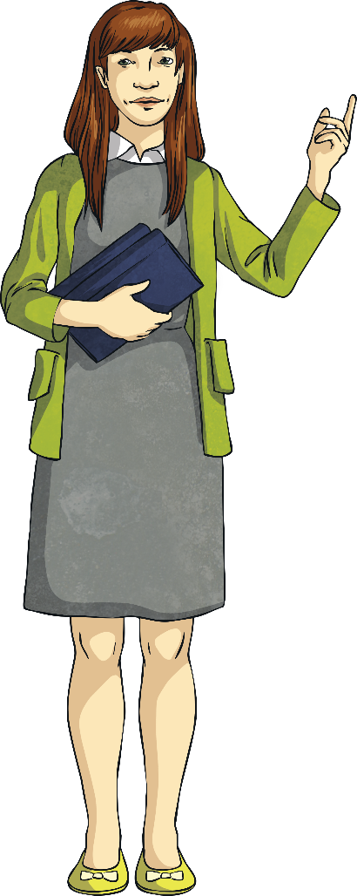
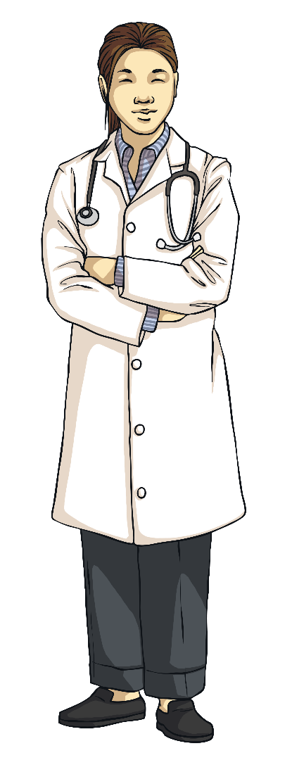
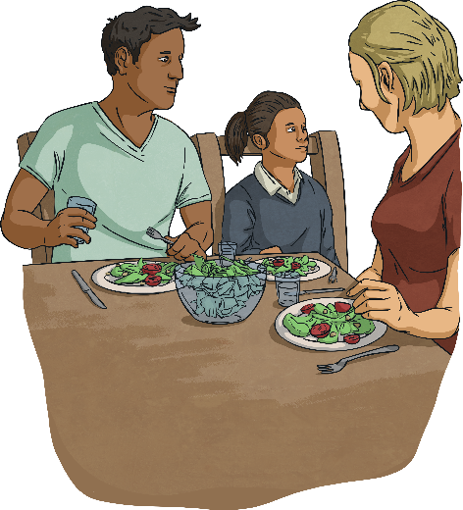
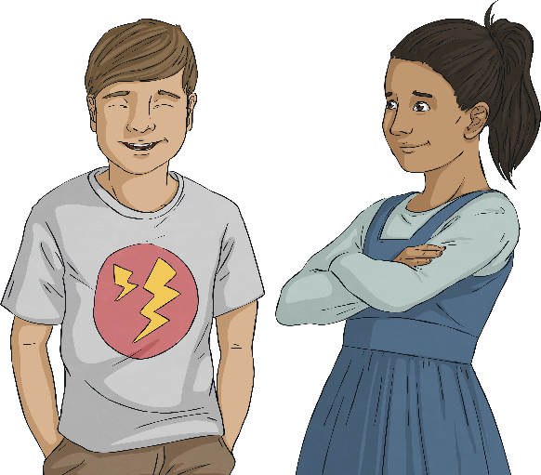
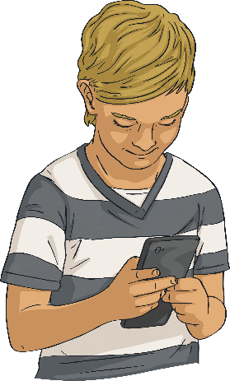
Plenary
Who could you go to if you feel worried about mental health?

